Slide 1
Regression Modeling for Taxi Fare Prediction
Our Team: -Ahmed Mohamed Sobhy
-Mohamed ABABSA
-Hassan Abd Elfattah Ibrahim Obaia

Slide 2
Dataset
500,000 taxi trips, 26 columns including times, fares, distances, and categorical features, an assumed NYC focus
2. Feature Engineering && Data Preprocessing
Removed rows with missing values from the dataset
Applied the IQR method to detect and remove outliers from the following features: fare_amount, distance, jfk_dist, ewr_dist, lga_dist, sol_dist, nyc_dist, bearing
Dropped the following features: pickup_latitude, pickup_longitude, dropoff_latitude, dropoff_longitude, User ID, User Name, Driver Name, key
Performed one-hot encoding on categorical features: Traffic Condition, Car Condition, Weather
Split the data into training and test sets (80% train, 20% test)
Standardized using StandardScaler()
data.shape (399683, 26)

Slide 3
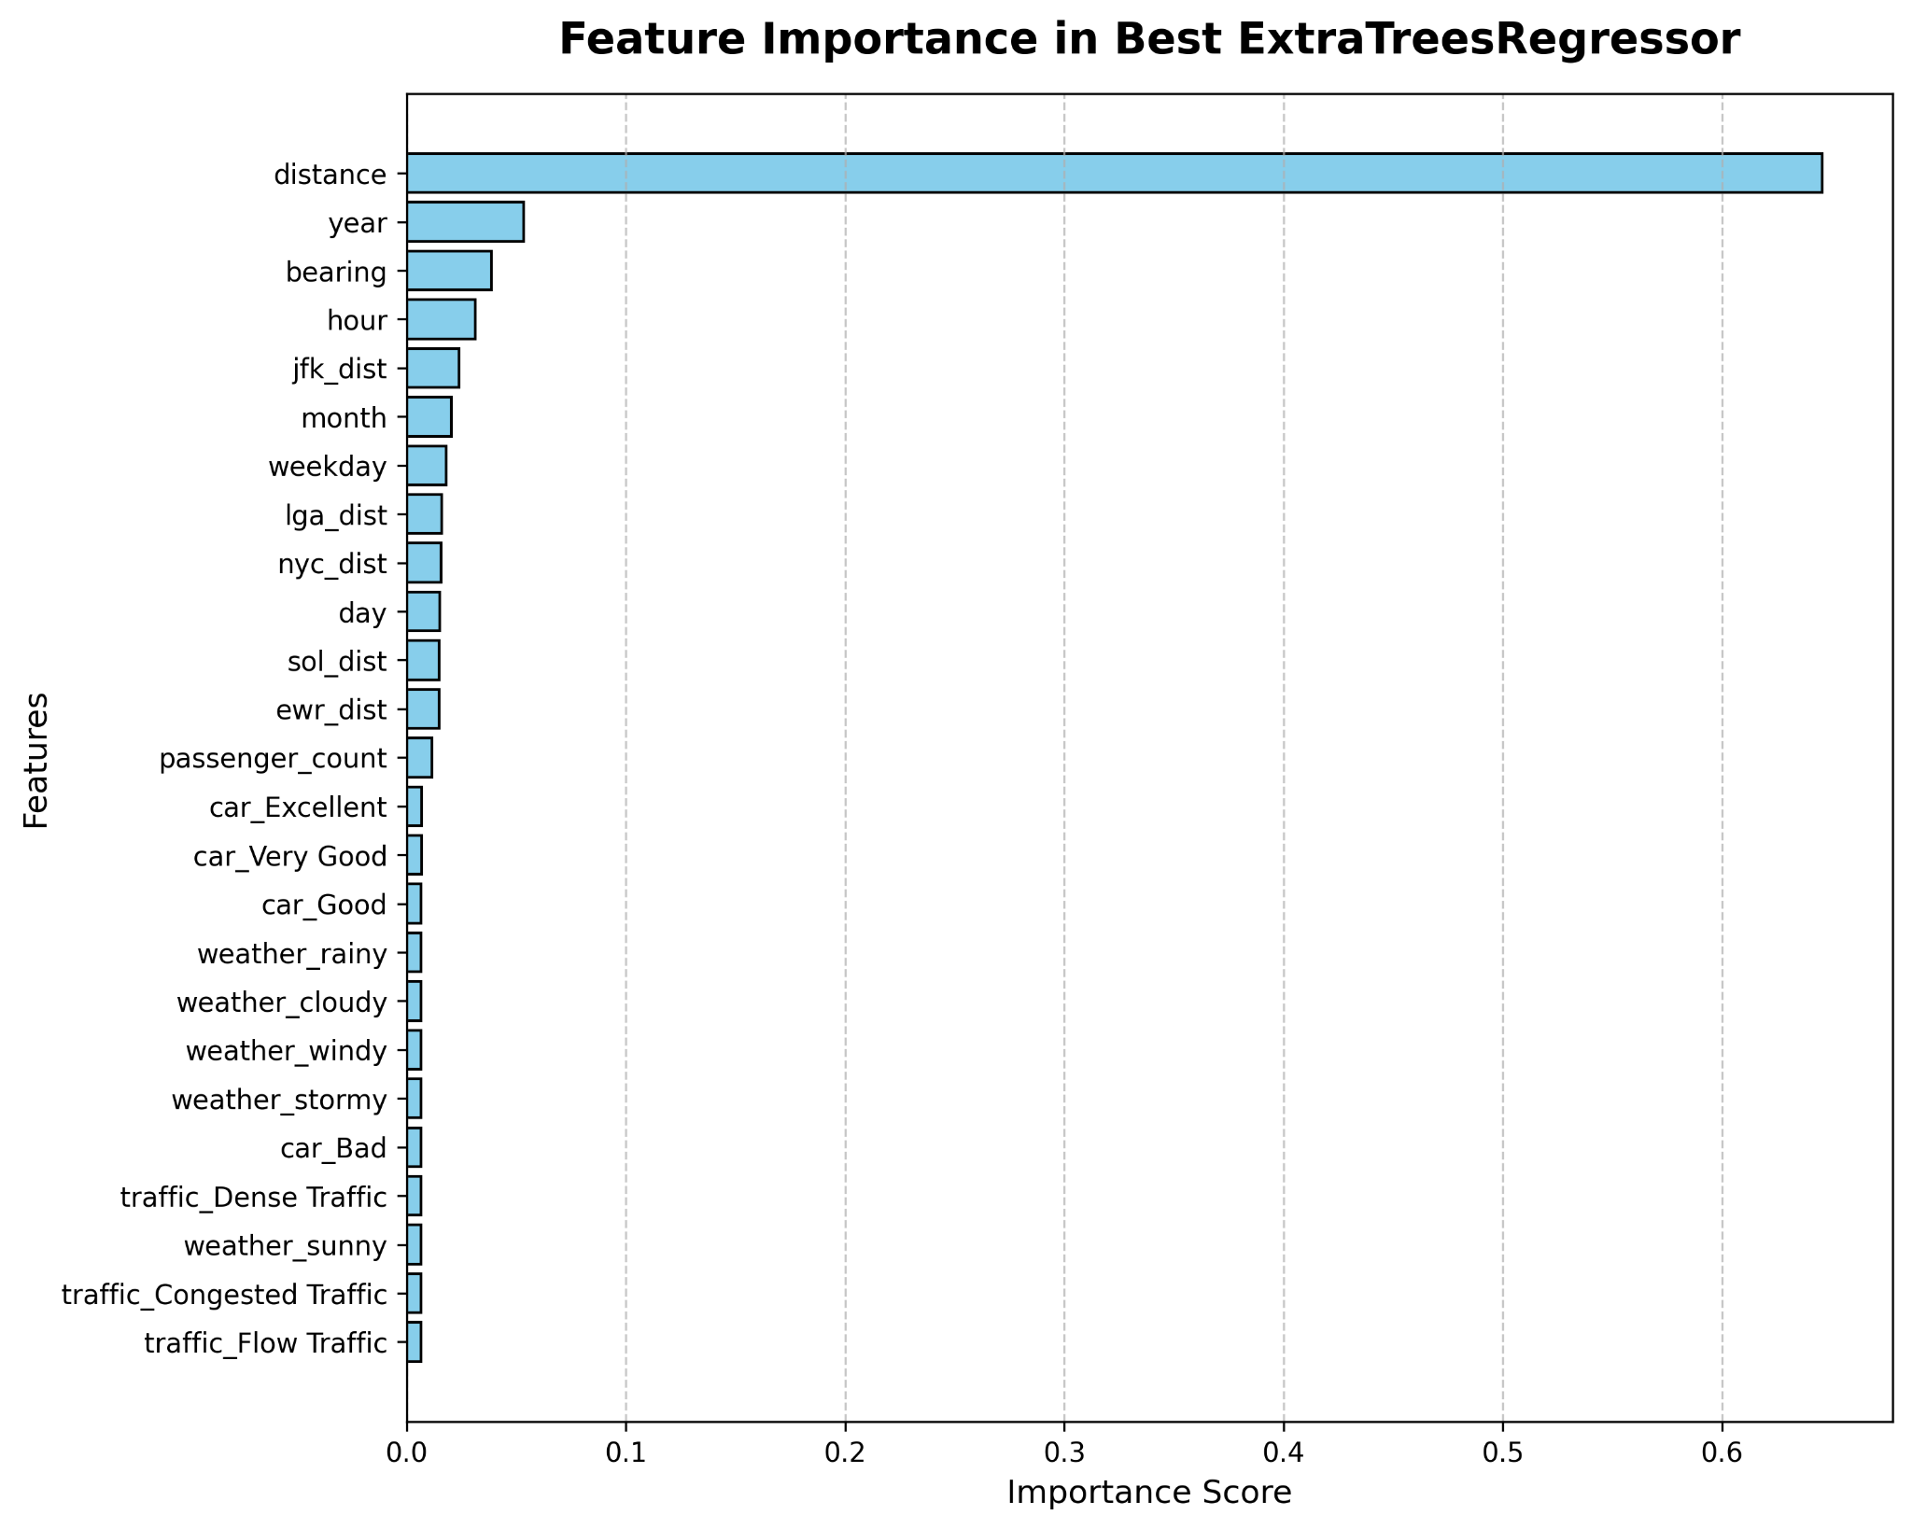
3. Feature Selection Using Extra Trees Method

Slide 4
4. Training Regression Models: Exploring Model Categories
Linear Regression Models:[
("Linear Regression", LinearRegression()),
("Ridge Regression", Ridge()),
("Lasso Regression", Lasso()),
("Elastic Net", ElasticNet()),
("Bayesian Ridge", BayesianRidge()),
("SGD Regressor", SGDRegressor(max_iter=1000)),
("Huber Regressor", HuberRegressor()),
("RANSAC Regressor", RANSACRegressor()),
("Passive Aggressive Regressor", PassiveAggressiveRegressor(max_iter=1000))
]
Tree-Based Models:[
("Decision Tree", DecisionTreeRegressor())
]

Slide 5
4. Training Regression Models: Exploring Model Categories
Ensemble Learning Models:[
("Random Forest", RandomForestRegressor(n_estimators=100)),
("Extra Trees", ExtraTreesRegressor(n_estimators=100)),
("Gradient Boosting", GradientBoostingRegressor(n_estimators=100)),
("AdaBoost", AdaBoostRegressor(n_estimators=100)),
("Bagging", BaggingRegressor(n_estimators=10)),
("XGBoost", XGBRegressor(n_estimators=100, objective='reg:squarederror')),
("LightGBM", LGBMRegressor(n_estimators=100)),
("CatBoost", CatBoostRegressor(n_estimators=100, verbose=0)),
("Hist Gradient Boosting", HistGradientBoostingRegressor())
]
Distance-Based Models:[
("KNN Regressor", KNeighborsRegressor())
]
Neural Network Models:[
("MLP Regressor", MLPRegressor(max_iter=100))
]

Slide 6
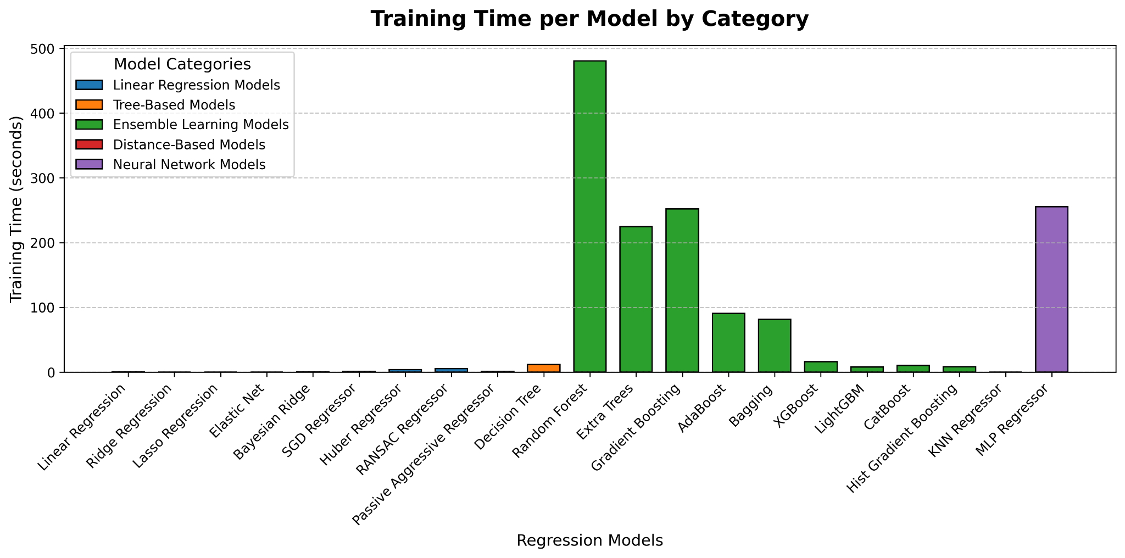
4. Training Regression Models: Exploring Model Categories

Slide 7
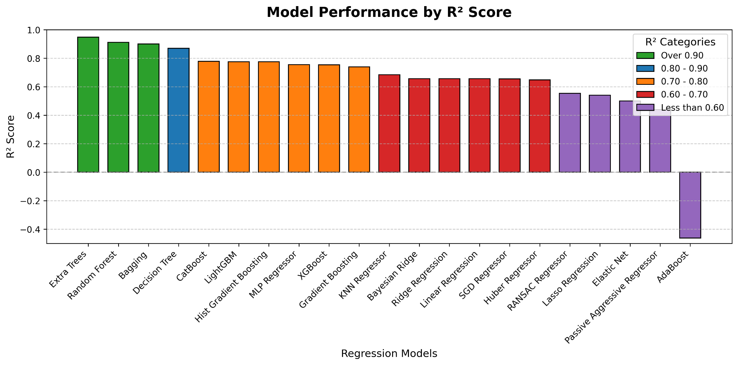
5. Evaluating Regression Models

Slide 8
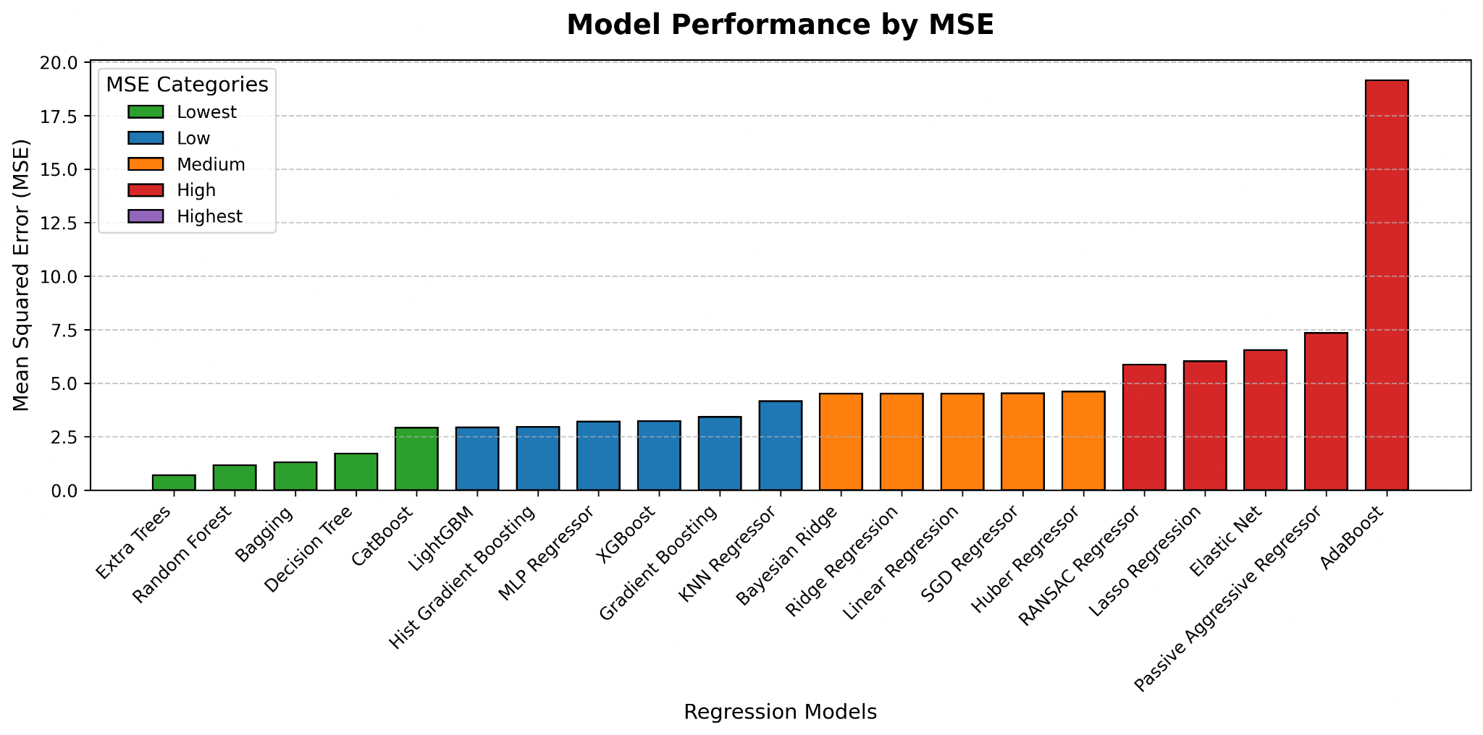
5. Evaluating Regression Models
Mean Squared Error (MSE)

Slide 9
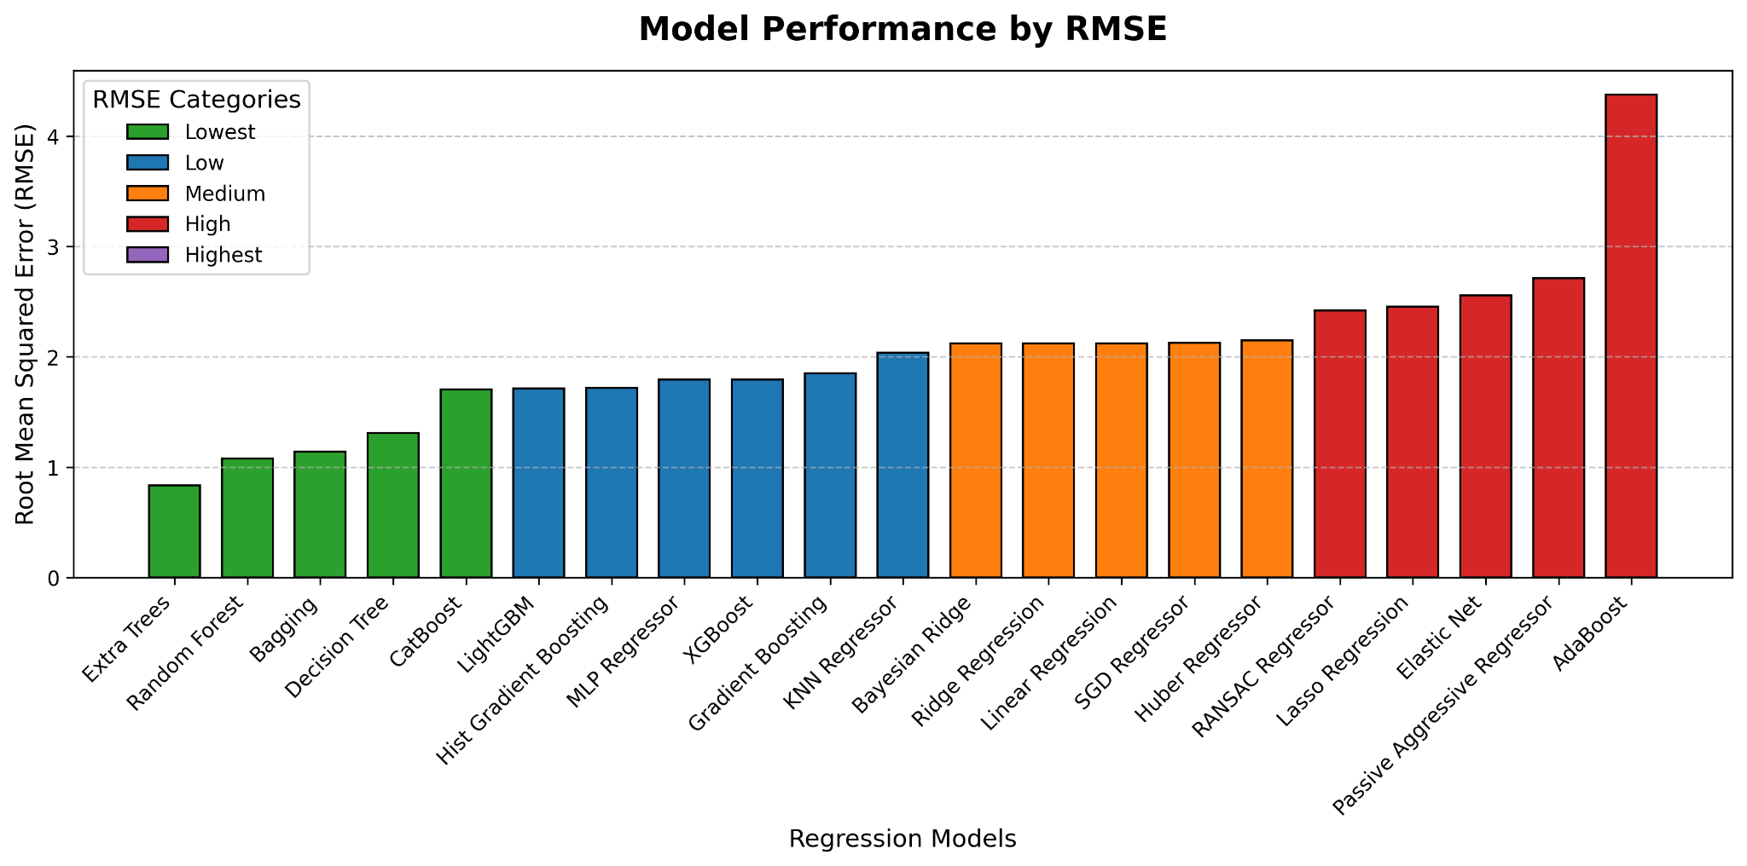
5. Evaluating Regression Models
Root Mean Squared Error (RMSE)

Slide 10
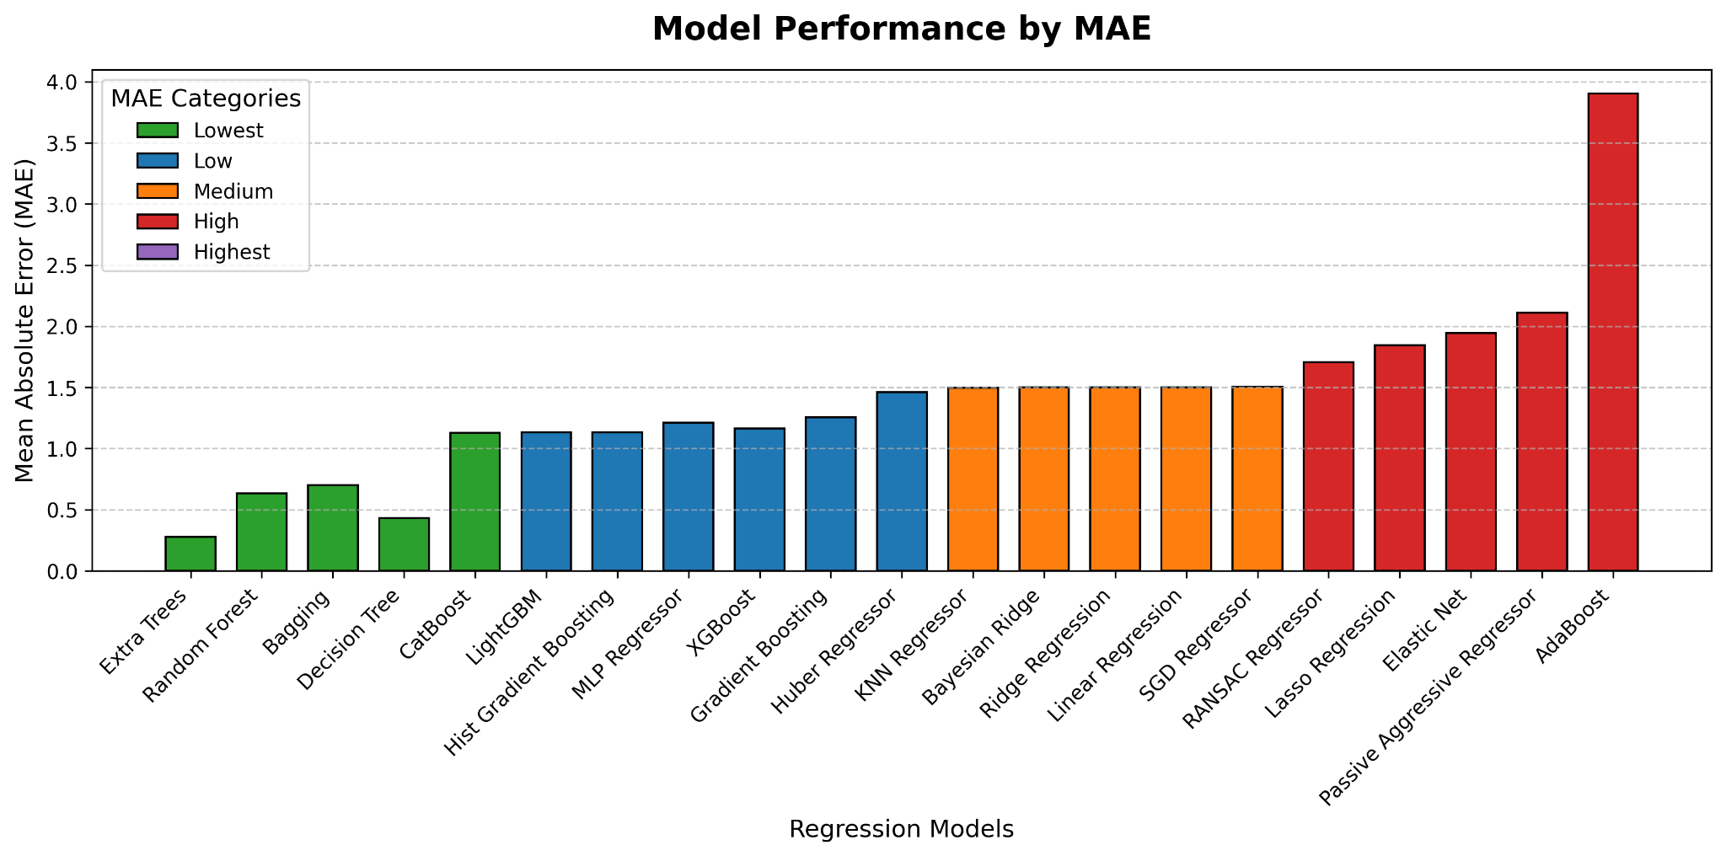
5. Evaluating Regression Models
Mean Absolute Error (MAE)

Slide 11
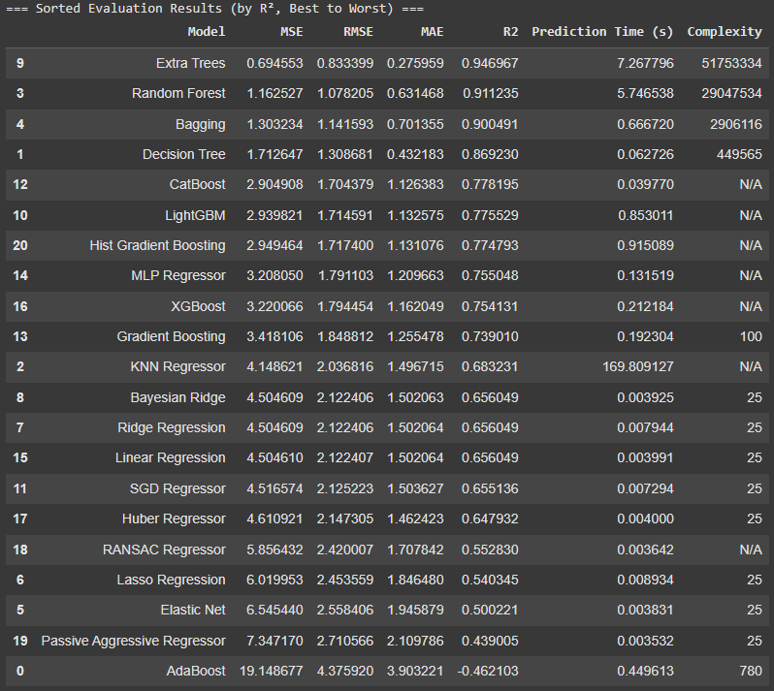
5. Evaluating Regression Models

Slide 12
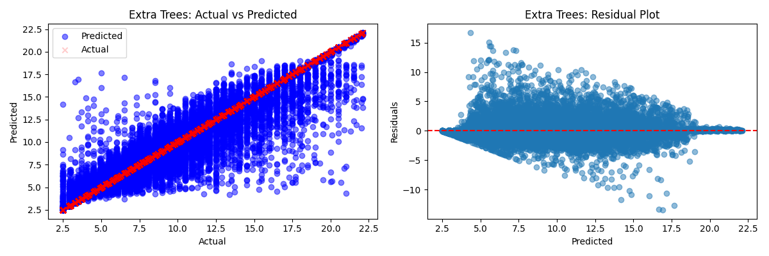
5. Evaluating Regression Models
Top 3 Highest-Performing Models (R2 over 0.90)

Slide 13
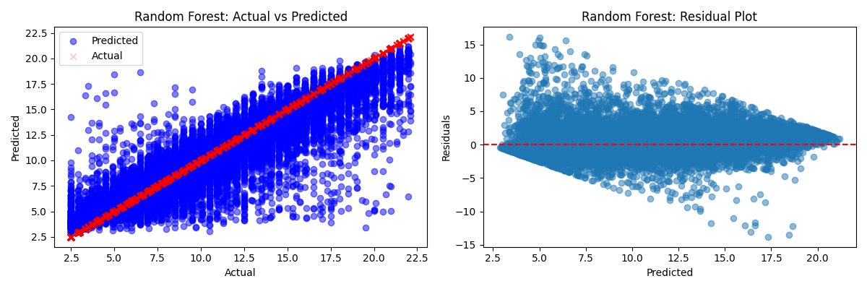
5. Evaluating Regression Models
Top 3 Highest-Performing Models (R2 over 0.90)

Slide 14
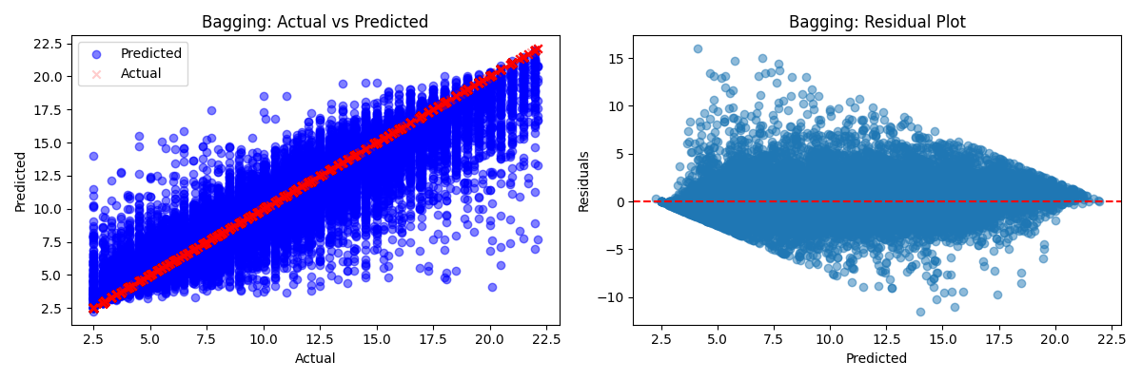
5. Evaluating Regression Models
Top 3 Highest-Performing Models (R2 over 0.90)

Slide 15
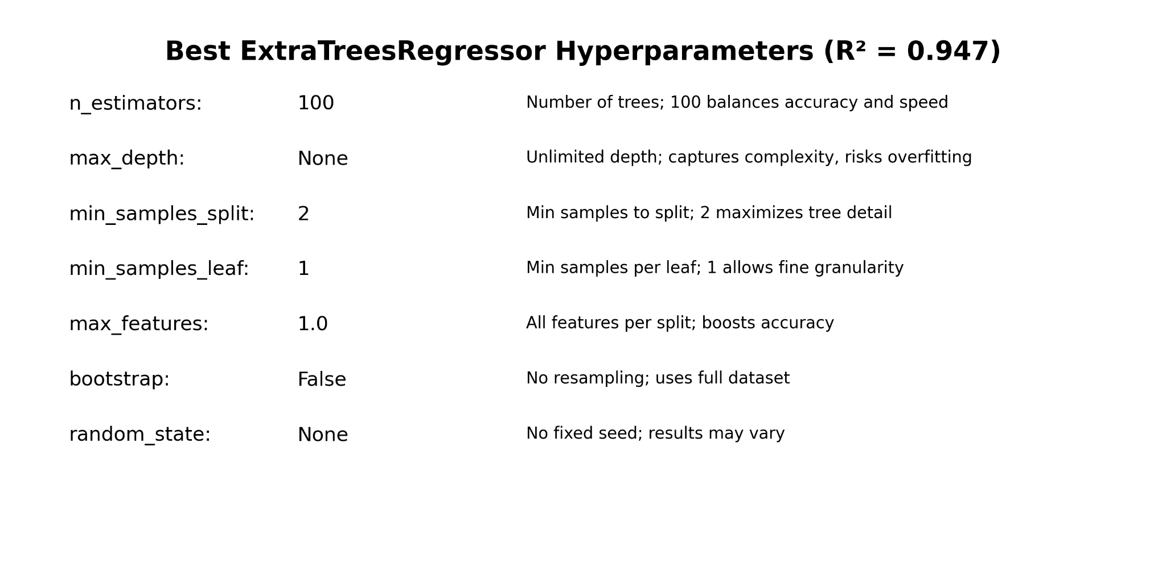
6. Best Model Hyperparameters: Extra Trees

